Slide 1
The Data Lakehouse

Slide 2

Get an insight into the Databricks lakehouse platform and understand its main features
Explore the Databricks workspace and familiarize yourself with the setup
Construct and oversee notebooks and clusters, and execute jobs for efficient data processing
Establish the data storage foundation utilizing the Databricks File System (DBFS) and the Delta Lake framework

Slide 3
Databricks Lakehouse Platform

Slide 4
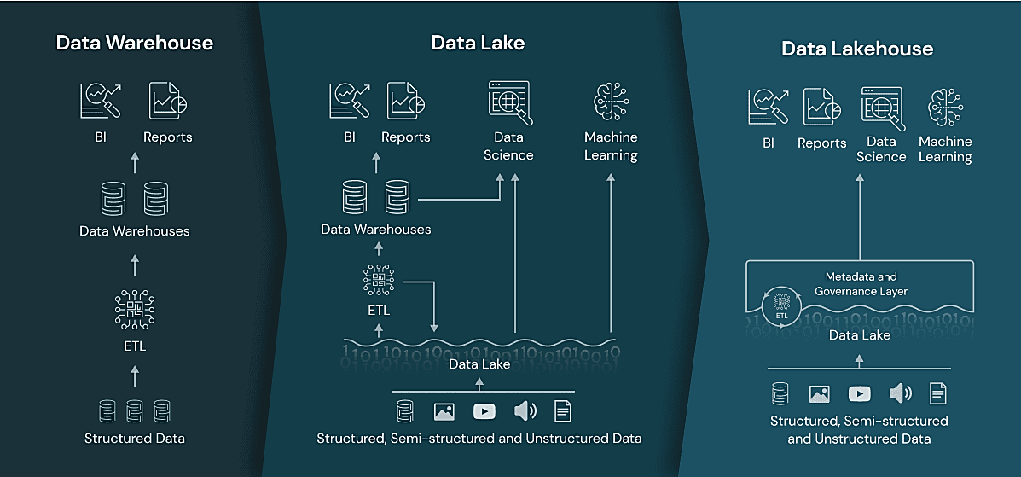
History of the Transition from Data Warehouse to Data Lakehouse
Source: https://www.databricks.com
Notes:
Data Warehouses are highly structured and are not suited for unstructured data analysis.
Data Lakes can handle a variety of data formats but may lack governance and query optimization.
Data lakehouse aims to provide the best of both worlds, with strong governance and support for all data types.
Real-world examples to illustrate the practical applications of each system - Data Warehouse for financial reporting, a Data Lake for research and development, and a Data lakehouse for comprehensive analytics across an enterprise.

Slide 5

Data Warehouses
They act as central repositories that store structured data from different sources.
They are specially designed for data querying and analysis.​
Notes:
Data Warehouses are designed for structured data. They excel in speedy, complex queries, like analyzing sales trends over five years. However, they are less adept with unstructured data, like customer reviews.

Slide 6
Data Warehouses: Advantages and Challenges
Advantages
Challenges
They provide quick responses to complex searches on
structured data and generally follow a
Schema on
Write approach.​
They are a bit rigid when dealing with unstructured or
semi-structured data. There can be scalability issues with very
large datasets.​
Notes:
The main advantage of data warehouses is that they provide fast responses to complex searches, and the main challenge of data warehouses is that they are rigid when dealing with unstructured or semi-structured data.
For instance, a retailer using a data warehouse can quickly generate reports on sales by region or product but may struggle to analyze customer sentiment from reviews without preprocessing. High initial setup costs and scalability can be challenging as data volume grows. It is a trade-off between fast, structured analytics and the flexibility to handle diverse data types.

Slide 7

Data Lake
It serves as massive storage space for all kinds of data, both unprocessed and organized.
They use a flexible schema-on-read method for processing data.
Notes:
Data Lakes allow the storage of vast, varied data types, including raw and unstructured data, using a schema-on-read approach for flexible processing.

Slide 8
Data Lake: Advantages and Challenges
Advantages
Challenges
They can accommodate huge and varied datasets, work with data including structured, unstructured, and semi-structured data, and are a
budget-friendly option for storing data.
Data governance and maintaining quality standards can be complex. Query performance may suffer without proper data organization
or indexing.
Notes:
The main advantage of Data Lake is that they can handle large and different unstructured or structured dataset. They are scalable, accommodate large volumes of data, and are cost-effective.
However, challenges include ensuring data governance and quality control, as the lack of structure can lead to disorganization, making data retrieval less efficient than structured repositories. For example, a media company could use a data lake to store everything from social media posts to video content, providing a wide-ranging dataset for analysis but requiring robust organization to ensure the data is usable.

Slide 9
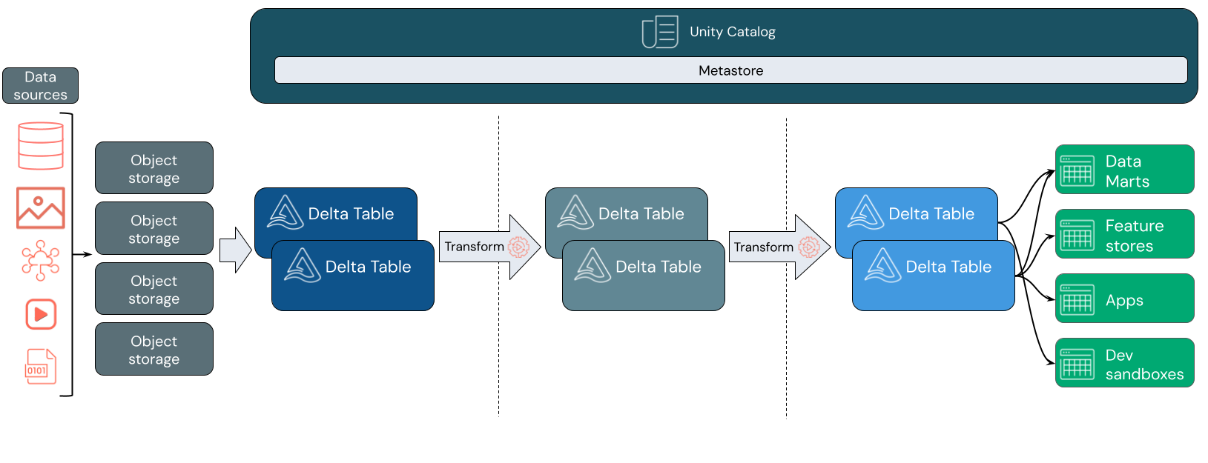
Data Lakehouse: Architecture
It aims to combine the best of both data warehouses and data lakes.
Source: https://docs.databricks.com/en/lakehouse/index.html
Notes:
The Lakehouse architecture aims to combine the best of both data warehouses and data lakes. It leverages the storage and flexibility of data lakes while incorporating features for structured data management, indexing, and query optimization, similar to data warehouses. ​
In this architecture, data from various sources is ingested into object storage, symbolizing the data lake component, which is capable of handling vast amounts of structured and unstructured data. This data is then structured into Delta Tables, which provide ACID transactions and efficient metadata handling, ensuring data reliability and quality. The Unity Catalog Metastore oversees the metadata across the entire data lifecycle, aiding in governance and security. The data is subsequently processed through transformation stages, leading to the creation of data marts, feature stores, apps, and development environments. This represents the data warehouse aspect, enabling sophisticated analytics and operational workflows.

Slide 10
Data Lakehouse: Advantages
Unified platform
Schema evolution
Provides a platform for structured and unstructured data
Helps organizations adapt to changing business needs and accommodate modifications in data structures
Query performance
Data governance
Incorporates indexing and optimization techniques for improved query performance
Enhances data governance and quality control features
Notes:
These are the main advantages of lakehouse.
It provides a unified platform. Allows for both schema-on-write and schema-on-read, accommodating evolving data requirements​. Incorporates indexing and optimization techniques for improved query performance​
Enhances data governance and quality control features.

Slide 11
Evolution of Lakehouse Platform
BI and reports
BI and reports
Data science
ML
BI and reports
Data science
ML
SQL APls
Dataframe APIs
Data warehouse
Data warehouse
Lakehouse
Metadata APIs
Metadata, caching, and indexing layer
ETL
ETL
Datalake
ETL
Datalake
Structured data
Structured and unstructured data
Structured and
unstructured data
. Data duplication
. Extra pipeline / sync
Gen1
Gen2
Gen3
Notes:
Traditional data warehouses are optimized for structured operational data and are primarily used for generating reports and insights through Business Intelligence (BI) tools, powered by ETL processes.
Delta Lake is an open-source storage layer that brings reliability to Data Lakes. It is capable of handling structured, semi-structured, and unstructured data. It integrates with ETL processes, supports real-time database functionalities, and facilitates data science and machine learning operations.
Lakehouse Platform aims to unify the strengths of Data Warehouses and Delta Lakes. It supports all types of data analytics, including machine learning, SQL queries, BI, and streaming use cases. The platform is designed to offer a single security and governance model across all clouds, addressing data management challenges in a multi-cloud environment. It's an open and reliable platform, suggesting it is built on open-source technologies and designed to efficiently handle diverse data types.

Slide 12
Data Lakehouse: Features
Some of the underlying technologies and trends that enhance the Lakehouse concept are:
Enhances the reliability of data lakes by adding ACID (Atomicity, Consistency, Isolation, and Durability) transactions
Delta Lake
Offers a table format designed for large-scale data systems
Iceberg
Empower scalable, adaptable, and efficient data management through
the principles of cloud computing
Cloud native data platforms
Combine data warehousing with data lake features through
managed solutions
Managed services
Simplify data integration and processing with infrastructure-free services
Serverless architectures
Notes:
The evolution from data warehouses to data lakes and the emergence of the Lakehouse concept reflect the industry's pursuit of a more versatile, scalable, and cost-effective solution for handling diverse data types and analytic workloads. This evolution is driven by the increasing volume, variety, and velocity of data generated in today's digital landscape. Some of the underlying technologies and trends that enable or enhance the Lakehouse concept are shown here.
Delta Lake: It is an open-source storage layer that brings ACID transactions to Apache Spark and big data workloads, enhancing reliability and data quality in data lakes.
Iceberg: It is another open-source project that provides a table format for large-scale data systems, supporting ACID transactions and efficient metadata operations.
Cloud-Native Data Platforms: Cloud-native data platforms use cloud computing principles to enable scalable, flexible, and efficient data management.
Managed Services: Cloud providers offer managed services like Amazon Redshift, Google BigQuery, and Azure Synapse Analytics that integrate data warehousing and data lake capabilities.
Serverless Architectures: The use of serverless data processing tools, such as AWS Glue and Azure Data Factory, simplifies data integration and processing without the need for infrastructure management.

Slide 13
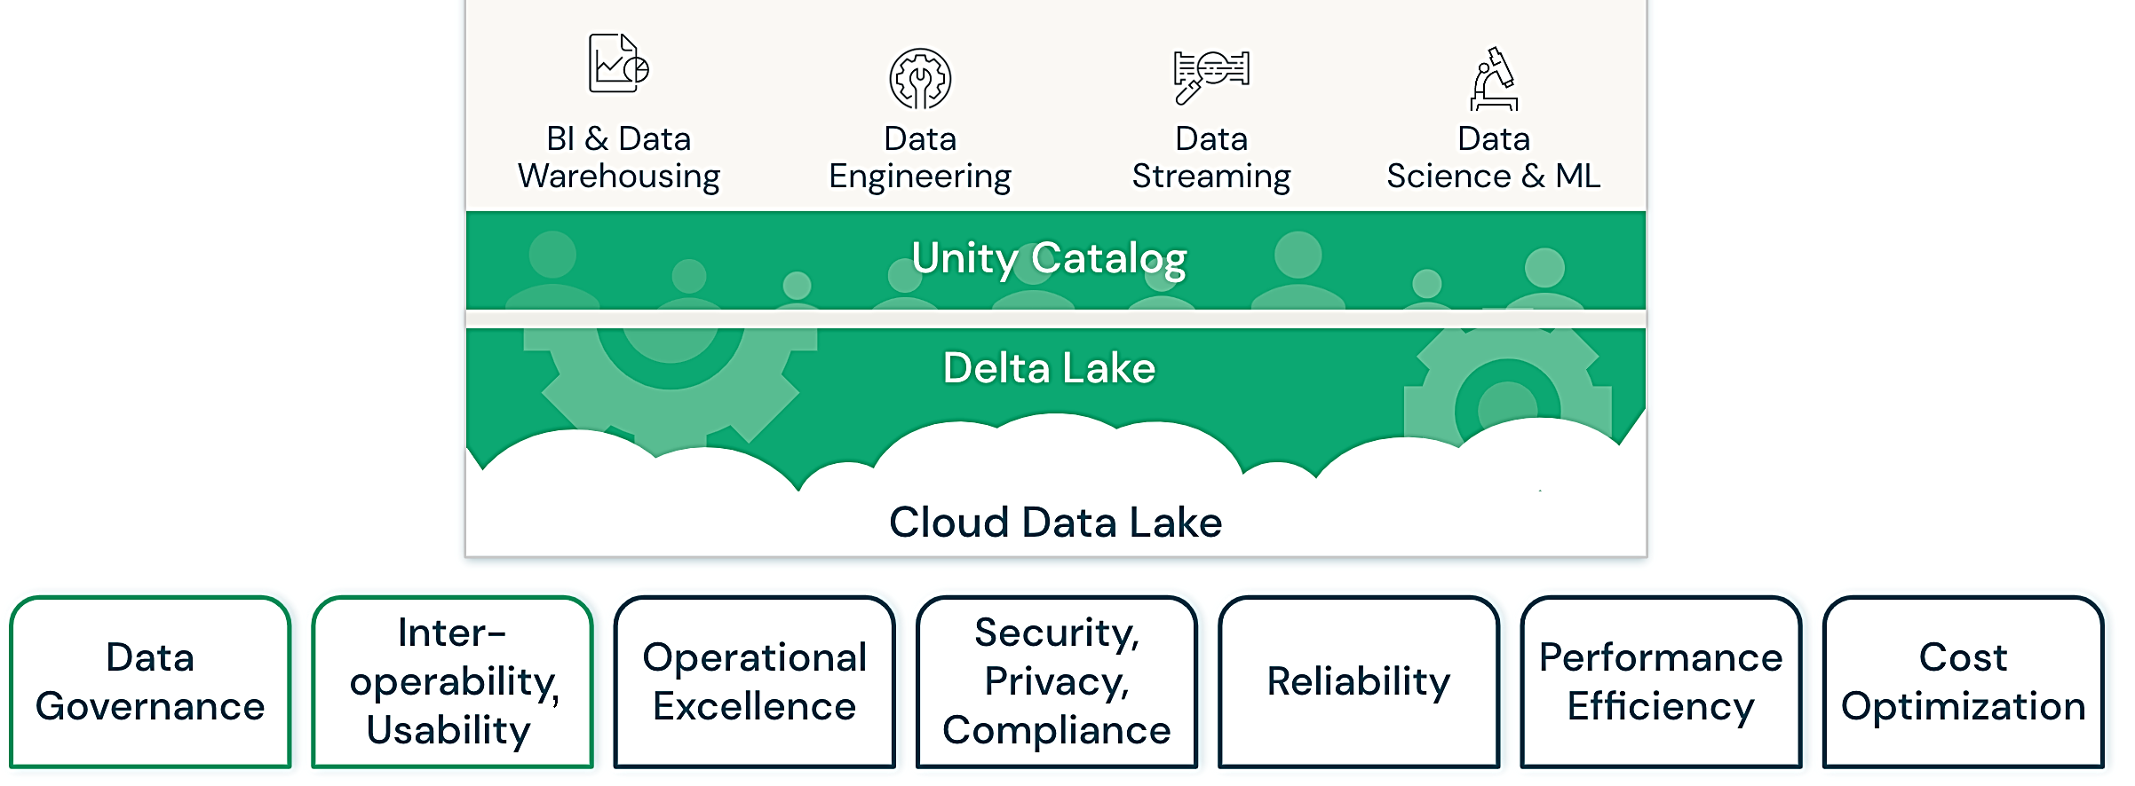
Databricks Lakehouse Platform
The structure of the lakehouse is as follows:
Source: www.databricks.com
Notes:
The slide illustrates the structure and benefits of Databricks Lakehouse, a unified data management platform that offers end-to-end capabilities for business intelligence, data warehousing, engineering, streaming, and machine learning.
BI and Data Warehousing: Enables comprehensive analytics and reporting functions
Data Engineering: Facilitates data preparation, transformation, and management
Data Streaming: Supports real-time data ingestion and processing.
Data Science and ML: Provides a platform for advanced analytics and machine learning models
Central to the architecture are the Unity Catalog and Delta Lake, which provide organization and storage solutions, respectively.
Unity Catalog: Serves as a metadata management layer that organizes data assets across the platform.
Delta Lake offers a reliable storage mechanism that maintains data integrity.
The foundation pillars outline the core strengths of the Databricks Lakehouse:
Data Governance: Ensures data security, quality, and compliance.
Interoperability and Usability: This ensures seamless integration with various tools and systems.
Operational Excellence: Focuses on the effective operation of data systems.
Security, Privacy, and Compliance: prioritizes the protection of data against unauthorized access and adheres to regulatory standards.
Reliability: Guarantees consistent and dependable data availability.
Performance Efficiency: Optimizes data processing speeds and analytics performance.
Cost optimization reduces expenses through efficient resource management.

Slide 14
Key Features of Lakehouse Architecture
The features that distinguish it as a unified and flexible platform for managing and analyzing data are:
Data governance
Query performance optimization
Transaction support
Schema flexibility
Data quality control
Unified storage
Open data formats
Cloud native considerations
Notes:
Understanding the Lakehouse architecture involves grasping the key principles and features that distinguish it from traditional data warehouses and data lakes. Here are the key aspects of Lakehouse architecture:
Unified Platform: ​​
Integration of Data Warehousing and Data Lakes: Lakehouse architecture combines the benefits of data warehousing and data lakes into a unified platform. It allows organizations to store structured and unstructured data in a single repository.
Schema Evolution: ​
Schema Flexibility: Lakehouse supports both schema-on-write and schema-on-read approaches. This flexibility is crucial for accommodating diverse data types and changing data requirements over time.
Evolutionary Changes: As the data evolves, the schema can be adapted without requiring a complete restructuring of the data. This is especially important in dynamic and rapidly changing business environments.
Query Performance: ​
Optimization Techniques: Lakehouse incorporates optimization techniques for query performance, addressing one of the historical challenges of data lakes. This includes indexing, caching, and other performance-enhancing mechanisms. ​
Accelerated Analytics: By optimizing queries, lakehouse architectures aim to provide faster and more efficient analytics, comparable to traditional data warehouses.
Data Governance and Quality:
Metadata Management: Lakehouse architectures often include robust metadata management capabilities, enabling better data governance and lineage tracking. This is crucial for ensuring data quality, compliance, and auditability. ​
Quality Control: The lakehouse approach helps address data quality issues commonly associated with data lakes, providing mechanisms for data validation and quality control.
​Transaction Support: ​​
ACID Transactions: Some lakehouse implementations, such as those based on Delta Lake or similar technologies, introduce ACID (Atomicity, Consistency, Isolation, Durability) transactions to data lakes. This enhances data reliability and consistency, making it more suitable for transactional workloads.
Data Quality Control: ​
Validation and Quality Checks: Lakehouse architectures include features for data validation and quality control. This helps identify and address data quality issues, ensuring that the data stored and processed is accurate and reliable.
Open Standards and Compatibility: ​
Compatibility with Open Formats: Lakehouse architectures often use open formats for data storage, such as Apache Parquet, which facilitates interoperability and compatibility with various data processing tools. ​
Interoperability: The use of open standards enables interoperability between different tools and systems within the data ecosystem.
Cloud-Native Considerations: ​
Managed Services: Many Lakehouse implementations are built on cloud-native platforms, leveraging managed services for scalability, reliability, and ease of maintenance. ​
Serverless Architectures: The adoption of serverless data processing tools in lakehouse architectures allows organizations to focus on data and analytics without the need for extensive infrastructure management.

Slide 15
Case Study: Understanding Lakehouse for Healthcare and Life Sciences

Slide 16
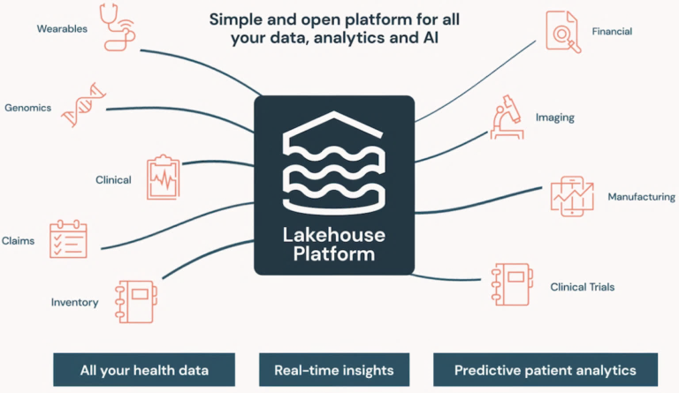
Lakehouse for Healthcare and Life Sciences
Lakehouse platforms help promote better patient outcomes and facilitate innovation in healthcare research and pharmaceutical manufacturing.​
Source: www.databricks.com
Notes:
When you combine the ease and functionality of a traditional warehouse with the speed and scalability of a data lake, you have a lakehouse. As Datanami’s Alex Woodie has noted, a lakehouse “provides the flexibility to handle less structured data types, such as text and image files, that are commonly used in data science and machine learning projects, but it also borrows from the data warehouse discipline, particularly in terms of ensuring the quality of the data and making sure that its lineage is tracked and governed.” Lakehouse platforms can automate the ingesting, processing, and optimizing of data within an infrastructure, which can enable companies to achieve more with their data—in this case, promoting better patient outcomes and facilitating innovation in healthcare research and pharmaceutical manufacturing.​
The opportunity for healthcare to be transformed with data and AI cannot be overstated. As organizations fully transition to electronic medical records, new data types like genomics evolve, and IoT and wearables take off, the industry is awash in massive amounts of data.

Slide 17
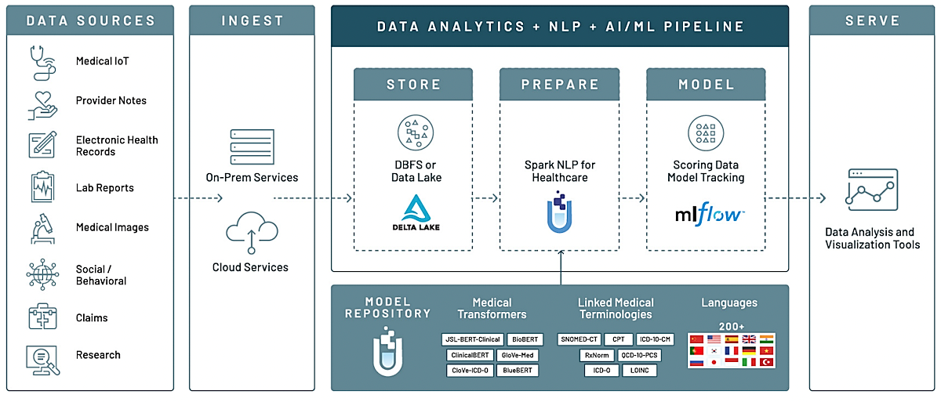
Lakehouse for Healthcare and Life Sciences
This illustrates the workflow from data ingestion to advanced analytics in the
healthcare domain.
Databricks lakehouse platform
Source: www.databricks.com
Notes:
The Databricks Lakehouse Platform is engineered to harness diverse healthcare data sources, such as medical IoT, EHRs, lab reports, and
research for insightful analytics.
Data ingestion is facilitated by both on-premise and cloud services, ensuring versatility in data acquisition.
Storage is managed by DBFS, or Delta Lake, providing robust and scalable data handling capabilities.
The preparation phase uses Spark NLP for healthcare to process and transform data, making it ready for analytical models.
MLflow is introduced as the model tracking tool within the modeling phase, supporting the deployment and management of machines.
learning pipelines.
The platform includes a model repository and medical transformers to streamline the development of AI and ML models.
It integrates various linked medical terminologies and supports multiple languages, enhancing global applicability.
The final phase involves serving the processed data to analysis and visualization tools, enabling end-users to draw actionable insights.

Slide 18
Lakehouse for Healthcare and Life Sciences
The essential aspects of the case study are as follows:
Innovative applications in healthcare
Cancer detection and early screening
Customized data and AI solutions
Data-driven approach
in healthcare and life sciences
Industry transformation and future outlook
Notes:
1. Innovative Applications in Healthcare: Companies like Cognoa and CareDx are using Databricks' AI to develop healthcare solutions. For instance, Cognoa is developing diagnostic and therapeutic products for pediatric behavioral health, while CareDx is advancing genomics-based solutions for transplant patients.
2. Cancer Detection and Early Screening: This can help in detecting cancer tumor DNA in the blood, facilitating early cancer screening and diagnosis from a single blood draw.
3. Databricks Lakehouse Benefits: The Lakehouse platform aids in eliminating data silos, fostering innovation, and driving a more data-driven approach in healthcare and life sciences. We recognize the important role that data plays in getting our products into the hands of those that need them the most, and the Databricks Lakehouse for Healthcare and Life Sciences solution helps us achieve that goal. This modern platform for data and AI has enabled us to eliminate costly data silos, unlock new opportunities to innovate, and become a more data-driven organization." Feng Liang, Sr. IT Director, Thermo Fisher Scientific.
4. Customized Data and AI Solutions: There are tailored solutions offered by Databricks’ Lakehouse, such as disease risk prediction, digital pathology classification, and the Real World Evidence Suite.
5. Industry Transformation and Future Outlook: Lakehouse addresses the challenges of data silos and leverages new data types (like genomics) and technologies (IoT, wearables) to drive better healthcare outcomes.
But this data is siloed, and teams don’t have the tools to properly use it,” said Michael Hartman, SVP of Regulated Industries at Databricks. “With Lakehouse for Healthcare and Life Sciences, we can drive transformation across the entire healthcare ecosystem and help empower our customers to solve specific industry challenges and, ultimately, drive better outcomes for the future of healthcare.

Slide 19
Databricks Compute: Notebooks, Clusters, and Jobs

Slide 20
Notebooks
They are dynamic, browser-based interfaces that permit collaborative coding, allowing data scientists, analysts, and engineers to write and execute code collectively.​
Machine learning model development​
01
02
Data exploration and analysis
Collaborative coding and knowledge sharing
04
03
Data visualization and reporting
Use cases
Notes:
The three components, Notebooks, Clusters, and Jobs, form the core of the Databricks platform, providing a collaborative and scalable environment for data analytics, machine learning, and big data processing. They work together to enable interactive data exploration, distributed processing, and automation of data workflows. Let us learn about Notebooks.
It is a dynamic, browser-based interface that permits collaborative coding, allowing data scientists, analysts, and engineers to write and execute code collectively.​

Slide 21
Notebooks: Key Features
Supports a variety of programming languages like Python, Scala, R, and SQL
Integrates with Apache Spark for distributed data processing
Combines programming, visualizations, and narrative text in a single interface
Facilitates data exploration, analysis, and visualization
Permits sharing for teamwork and procedural documentation
Notes:
These are the key features of Notebook.

Slide 22
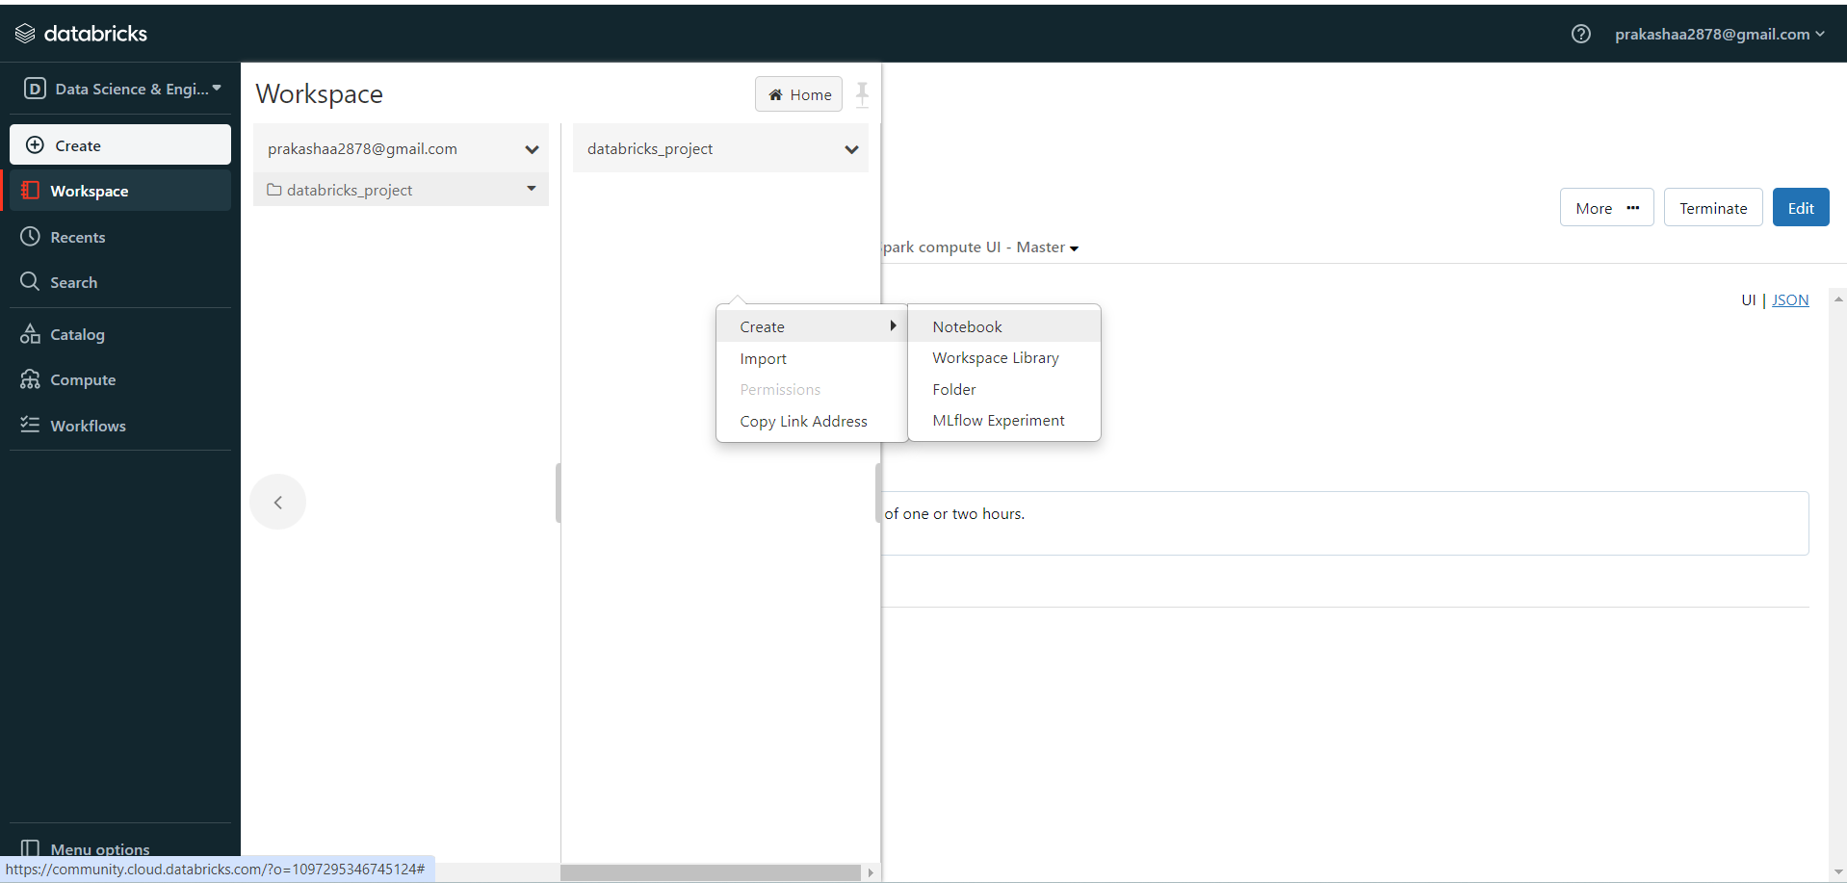
Create a Notebook
Go to Workspace and select the email id from Users dropdown. Right-click on white space, select Create, and then click on Notebook.
Source: www.databricks.com
Notes:
This is how we create a Notebook in Databricks Workspace.
On the left, the navigation bar provides quick access to various functionalities such as creating new resources, accessing the workspace, viewing recent files, searching, catalog browsing, computing resources, and managing workflows. In the main pane, there is an option to create new items within the workspace, with a dropdown menu offering choices like Notebook, Workspace Library, Folder, and MLflow Experiment.

Slide 23
Clusters
Clusters are computational resources used to execute code in Databricks; they consist of one driver node and multiple worker nodes that collectively run distributed data processing tasks.
Its use cases are as follows:
Large-scale data processing and analysis in a distributed manner
Collaborative analysis in a
shared environment
Execution of Spark-based ETL (Extract, Transform, Load) jobs
Scalable machine learning
model training
Notes:
The slide covers the concept, features, and use cases of ‘Clusters' within the Databricks platform.

Slide 24
Clusters: Key Features
Customizes configurations for size, machine types, and Spark settings
Adapts worker nodes to task demands
with an
auto-scaling feature
Employs Apache Spark for efficient parallel processing of extensive data sets
Employs Apache Spark for efficient parallel processing of extensive data sets
Notes:
These are key features of ‘Clusters' within the Databricks platform.

Slide 25
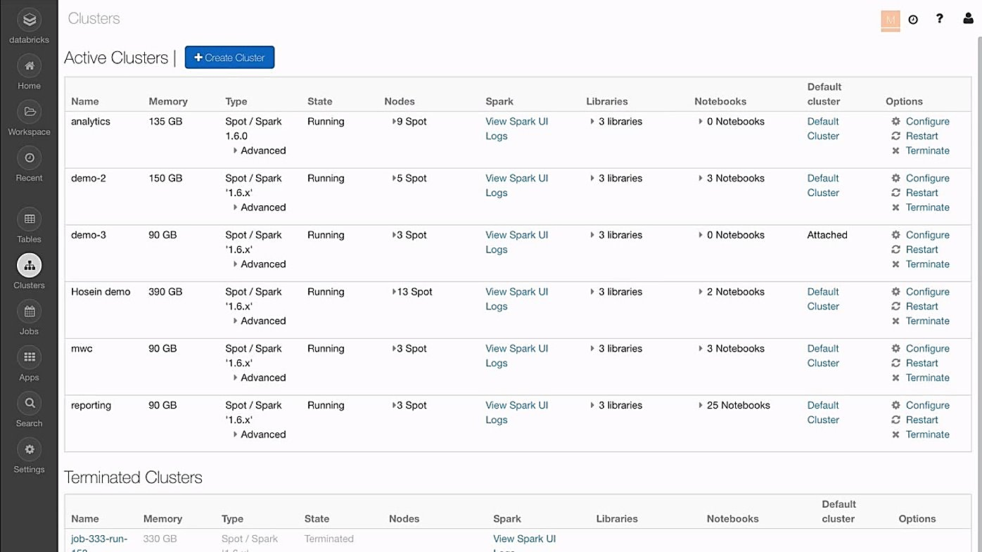
Clusters on Databricks
Source: www.databricks.com
Cluster management section of the Databricks platform
Notes:
This shows a list of active and terminated clusters, along with key details. Each cluster is listed with its name, allocated memory, type (Spot or Spark), current state (Running or Terminated), number of nodes, associated Spark version, linked libraries, the number of notebooks that are using the cluster, and its default status. The interface provides options to view the Spark UI logs, configure, restart, or terminate clusters. The 'Active Clusters' section shows that there are several clusters currently running, with varying memory capacities and node counts, indicating a robust and scalable environment for data processing and analysis tasks. The 'Terminated Clusters' section at the bottom indicates clusters that have been shut down, with a similar set of details provided.

Slide 26
Jobs
They are scheduled or one-time data processing tasks designed to automate workflows, execute notebooks, JAR files, or Python scripts. The following are the use cases:
Trigger machine learning model training at regular intervals
Manage and direct the execution of complex workflows
Automate ETL processes and data pipelines
Schedule data analysis and reporting
Notes:
The slide covers the concept, features, and use cases of 'Jobs' within the Databricks platform.

Slide 27
Jobs: Key Features
Helps schedule recurring jobs with a customizable frequency​
Offers configurable settings for job parameters, timeouts, and retries
Provides a tracking feature to monitor job execution and view job logs for debugging
Supports integration with external systems and services​
Simplifies the sequence of data processing and analytics workflows
Notes:
The slide covers the features of 'Jobs' within the Databricks platform.

Slide 28
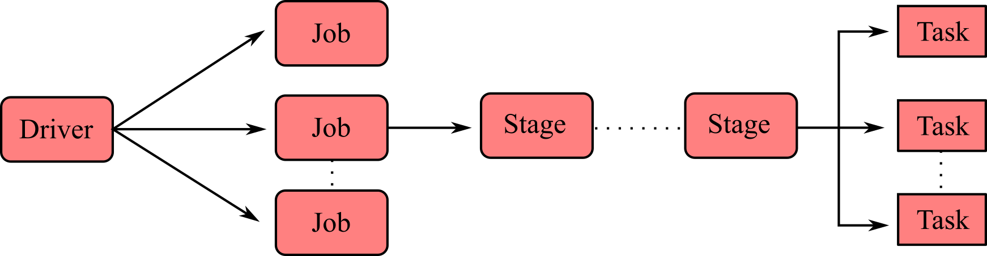
Job Stages
The below image illustrates the lifecycle of a Databricks job, from initial configuration through execution, monitoring, and cleanup to cluster termination.
Configuration
Job execution
Cluster initialization
Task execution
Monitoring and logging
Completion and results
Cleanup and cluster termination
Jobs in Databricks
Notes:
Job Stages: ​
Configuration:​
Define the job settings, such as the type of task to perform (for example, run a notebook, execute a JAR file, or run a Python script). ​
Specify the notebook or script to execute and provide any required parameters. ​
Configure scheduling options, such as frequency and time of execution.
Job Execution: ​
When a job is triggered based on the configured schedule or manually started, the Databricks platform initiates the execution process.​
The job engine launches the necessary clusters or reuses existing ones to perform the specified task. ​
Cluster Initialization:​​
If the job involves running code on a cluster, Databricks initializes the cluster, which includes setting up the driver node and worker nodes. ​
Cluster initialization involves configuring Spark settings, loading required libraries, and preparing the environment for code execution. ​
Task Execution: ​​
The actual execution of the defined task takes place. This could involve running code in a notebook, executing a JAR file, or running a Python script. ​
Distributed processing tasks are performed on the Spark cluster, enabling scalable and parallel execution.​
Monitoring and logging:
Throughout the job execution, Databricks provides real-time monitoring and logging capabilities. ​
Users can view the progress of the job, monitor resource usage, and access logs for debugging and troubleshooting purposes.
Completion and Results: ​
Once the job execution is complete, Databricks provides information about the job's status, including whether it succeeded or encountered errors. ​
Users can review the output, logs, and results generated by the job to assess the outcome of the task.
Cleanup and Cluster Termination: ​
Depending on the configuration, Databricks may terminate the cluster used for the job to release resources. ​
Cleanup tasks, such as closing connections or releasing temporary files, are performed as part of the job completion process.
Jobs in Databricks:
Jobs in Databricks provide a way to automate and schedule various data processing and analytics tasks, promoting efficiency and repeatability in workflows. The platform's job management features simplify the orchestration of complex data pipelines and analysis processes.

Slide 29
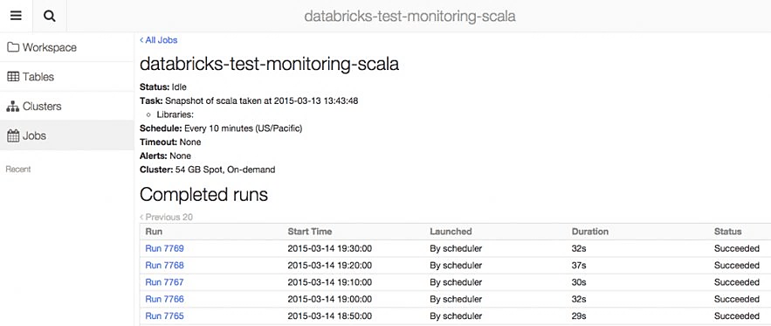
Executing Jobs
In the Jobs section of Databricks, specific tasks are scheduled and executed.
The above example shows a job titled databricks-test-monitoring-scala, with its Status as idle, indicating no current execution.
Source: www.databricks.com
Notes:
This features a job titled 'databricks-test-monitoring-scala', with its status as idle, indicating no current execution, and it also shows all the completed jobs along with their duration.

Slide 30
Databricks File System (DBFS)

Slide 31
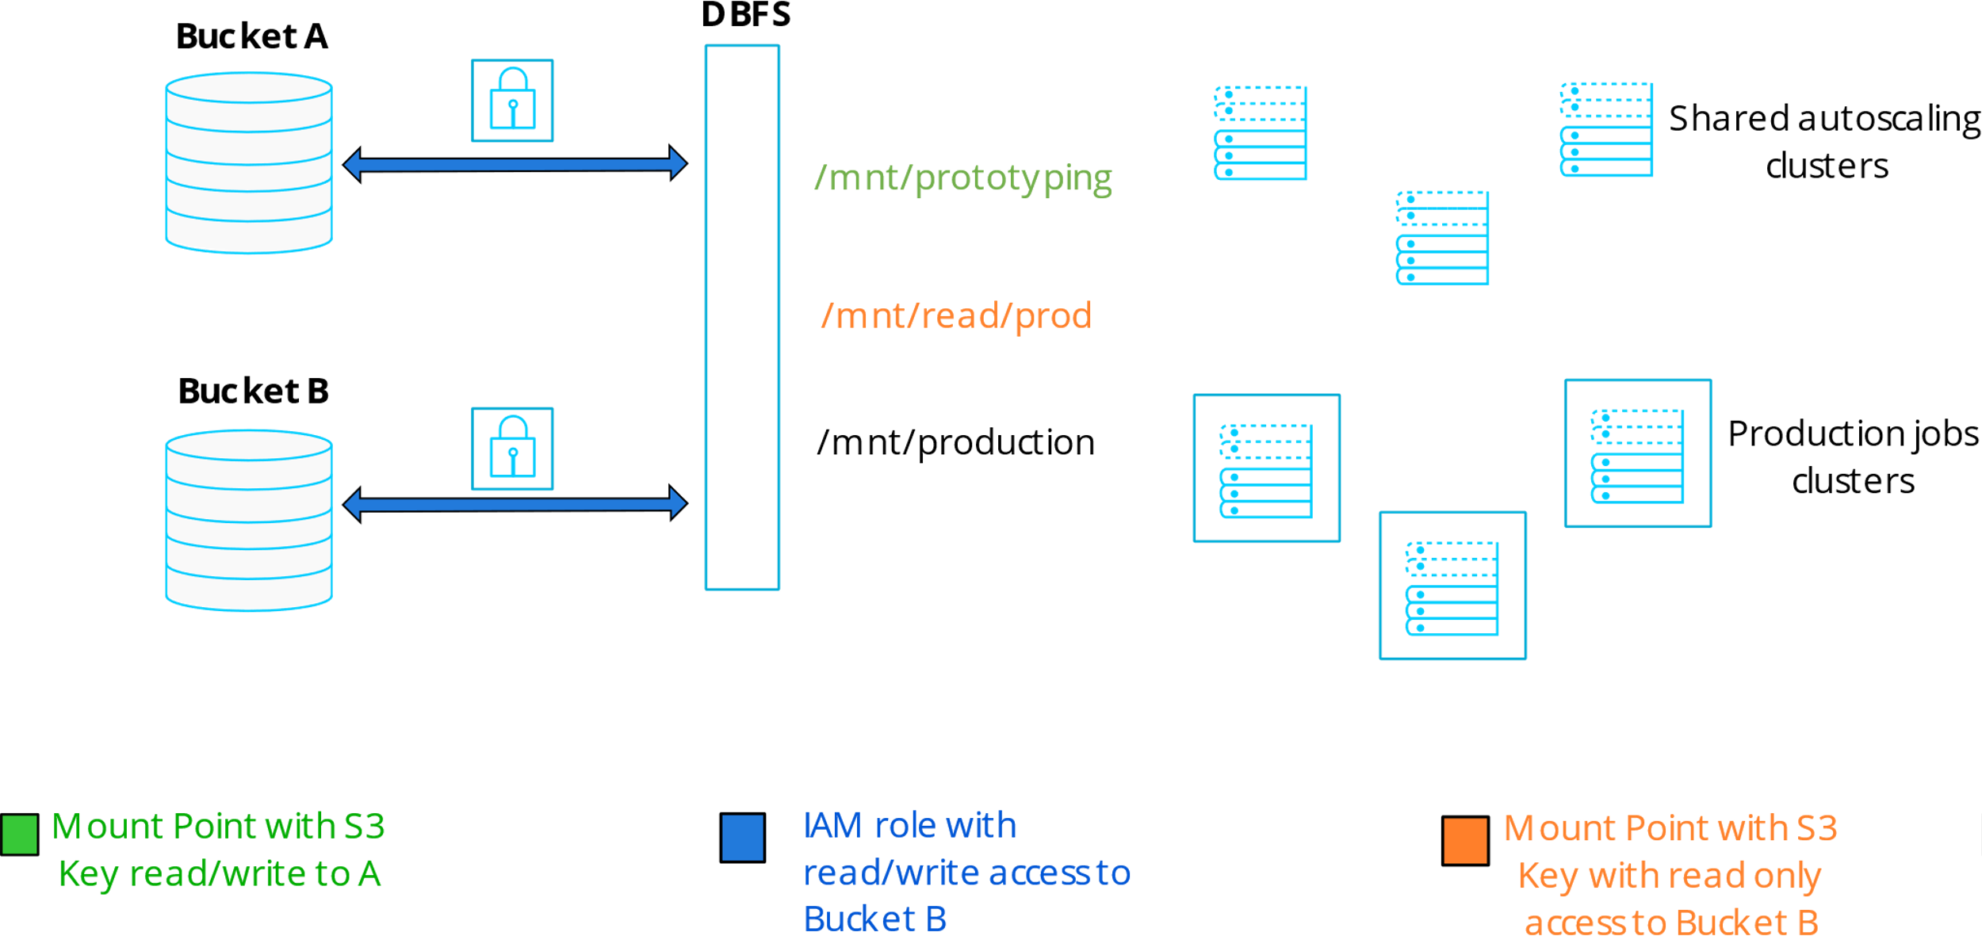
Databricks File System
DBFS is distributed file system integrated within Databricks workspaces, ensuring its accessibility across all clusters in Databricks. It is built on top of existing object storage. Below is the example:
DBFS mounts points configured with various access levels to AWS S3 buckets.
Notes:
The Databricks File System (DBFS) is a distributed file system mounted into a Databricks workspace and available on Databricks clusters. DBFS is an abstraction on top of scalable object storage that maps Unix-like filesystem calls to native cloud storage API calls.
DBFS is an intermediary layer facilitating access control and collaboration by mounting Amazon S3 buckets for use with shared autoscaling and production job clusters.

Slide 32
DBFS: Key Features
File storage
Integrates with cloud object storage as an underlying layer
Access and mounting
Accessible from various components within Databricks
DBFS paths
dbfs:/FileStore is the default storage directory.
dbfs:/mnt is commonly used as a prefix for mounted external storage
File formats
Compatible with multiple file formats like Parquet, CSV, JSON, and Delta Lake
File management
Offers a user interface for file uploading, downloading, and management
Notes:
1. File Storage:​
DBFS stores files in a Databricks workspace and is accessible to all clusters within that workspace.​
It integrates with cloud object storage, which is used as the underlying storage layer. For example, in Azure Databricks, it uses Azure Blob Storage.​
2. Access and Mounting:​
Access: DBFS is accessible through notebooks, jobs, and clusters in a Databricks workspace.​
Mounting: External storage can be mounted to DBFS, making it easy to access files stored externally from within Databricks.​
3. DBFS Paths:​
dbfs:/FileStore: This is the default directory for storing user files in DBFS.​
dbfs:/mnt: External mounts are often prefixed with /mnt when mounted.​
4. Supported File Formats:​
DBFS supports various file formats, including Parquet, CSV, JSON, and Delta Lake.​
5. File Management:​
Files can be uploaded, downloaded, and managed through the Databricks workspace UI.​
DBFS is often used for storing data files, libraries, and other resources needed for analysis.​
6. DBFS Utilities:​
Databricks provides utilities for interacting with DBFS within notebooks and jobs. For example, %fs commands can be used to perform file operations.​
7. DBFS FileStore:​
The dbfs:/FileStore directory is commonly used for storing user-specific files. Each user has a directory within FileStore to store and manage their files.
8. DBFS CLI:​
Databricks provides a command-line interface (CLI) for interacting with DBFS. It allows users to perform operations such as uploading, downloading, and listing files.​
9. Databricks File Mounts:​
External storage, such as Azure Blob Storage or AWS S3, can be mounted to DBFS for seamless access.​
This enables users to read and write data to external storage locations directly from within Databricks notebooks.​
10. Notebook Attachments:​
Notebooks in Databricks can include references to files stored in DBFS, making it easy to share notebooks with associated resources.

Slide 33
DBFS: Key Features
DBFS utilities
Provides tools and commands within Databricks for file operations
DBFS FileStore
A directory for storing user-specific files, with individual directories
for users
DBFS CLI
A command-line interface for managing files in DBFS
File mounts
Capable of mounting external storage like Azure Blob Storage or AWS
S3 for direct data access
Notebook attachment
Enables referencing DBFS files in Databricks notebooks for sharing
Notes:
1. DBFS Utilities:​
Databricks provides utilities for interacting with DBFS within notebooks and jobs. For example, %fs commands can be used to perform file operations.​
2. DBFS FileStore:​
The dbfs:/FileStore directory is commonly used for storing user-specific files. Each user has a directory within FileStore to store and manage their files.
3. DBFS CLI:​
Databricks provides a command-line interface (CLI) for interacting with DBFS. It allows users to perform operations such as uploading, downloading, and listing files.​
4. Databricks File Mounts:​
External storage, such as Azure Blob Storage or AWS S3, can be mounted to DBFS for seamless access.​
This enables users to read and write data to external storage locations directly from within Databricks notebooks.​
5. Notebook Attachments:​
Notebooks in Databricks can include references to files stored in DBFS, making it easy to share notebooks with associated resources.

Slide 34
Delta Lake

Slide 35

Delta Lake
It is an open-source storage layer, forming the core for data and table storage in the Databricks lakehouse.
I
It runs on top of existing data lakes, improving their reliability, performance, and scalability.
Notes:
​Delta Lake is an open-source storage layer that brings ACID (Atomicity, Consistency, Isolation, Durability) transactions to Apache Spark and big data workloads. Delta Lake is commonly used in Databricks environments to manage and optimize large-scale data processing workflows.

Slide 36
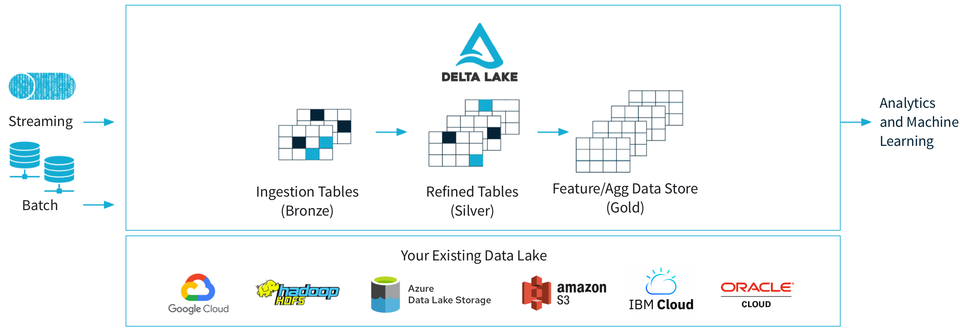
Delta Lake Workflow
It brings ACID transactions to Apache Spark and big data workloads.
Data and analytics workflow
Source: www.delta.io
Notes:
Delta Lake is commonly used in Databricks environments to manage and optimize large-scale data processing workflows.
It illustrates the data processing and storage workflow, showing how various data sources like streaming and batch are ingested into Delta Lake as bronze tables, then refined into silver tables, and ultimately transformed into gold tables for analytics and machine learning purposes. The workflow includes integrations with various technologies and platforms, such as Apache Spark, Snowflake, and Kafka, and shows the compatibility of Delta Lake with existing data lakes from different cloud providers like Google Cloud, Amazon S3, and IBM Cloud.

Slide 37
Delta Lake: Components
ACID transactions
It ensures that operations on tables are atomic, consistent, isolated, and durable.
Time travel
It allows users to query and revert to earlier versions of a Delta table.
Transaction log
It records all the transactions.
Delta table
It organizes data into tables.
Batch and streaming​​
It serves as a unified storage layer for both batch and streaming data processing.
Schema evolution
It supports schema evolution, allowing users to modify the schema of a table
without requiring a full rewrite of the data.
Optimizations
​ It includes optimizations for query performance.
Notes:
ACID Transactions:​
​Delta Lake introduces ACID transactions to data lakes, ensuring that operations (such as inserts, updates, and deletes) on tables are atomic, consistent, isolated, and durable. This helps maintain data integrity and consistency in the face of concurrent operations.​
Transaction Log:​
All changes made to a Delta table are recorded in a transaction log. This log is a single source of truth for changes, providing a record of committed transactions and enabling features like time travel.​
Delta Table:​
Delta Lake organizes data into tables, which can be created and manipulated using standard SQL-like commands. Delta tables are stored in a Delta format, which includes the data files and transaction logs.
Schema Evolution:
Delta Lake supports schema evolution, allowing users to modify the schema of a table without requiring a full rewrite of the data. This is achieved by maintaining the schema history in the transaction log.
Time Travel:​
The transaction log enables time travel, allowing users to query and revert to earlier versions of a Delta table. This feature is beneficial for auditing, debugging, and recovering from errors.​
Batch and Streaming:​​
Delta Lake serves as a unified storage layer for both batch and streaming data processing. It seamlessly integrates with Spark Structured Streaming, providing consistency and reliability in real-time data processing.​
Optimizations:​
​Delta Lake includes optimizations for query performance. Features like data skipping and ZORDER clustering enhance query speeds by skipping irrelevant data and organizing data for more efficient reads.​

Slide 38
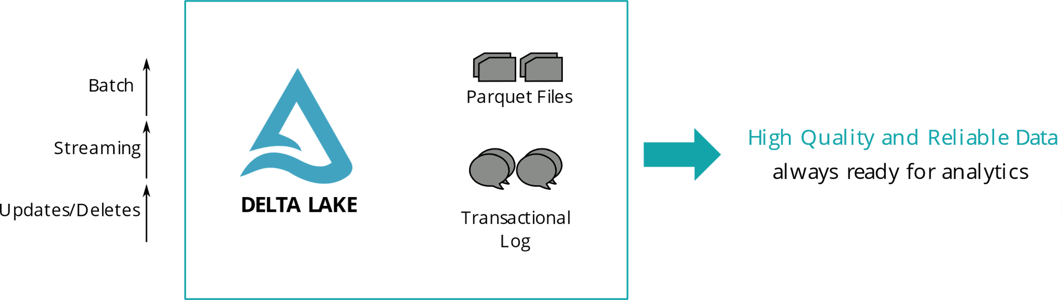
Why Delta Lake Matters
It addresses common challenges associated with data lake by providing a reliable, scalable, and feature-rich storage layer that enhances data consistency, supports schema evolution, and simplifies data processing workflows.
I
It contributes to the robustness and efficiency of big data analytics and machine learning applications.​
Notes:
Delta Lake enhances reliability and consistency through these key features:
ACID Transactions:​
​Delta Lake introduces ACID transactions to data lakes, ensuring that operations (such as inserts, updates, and deletes) on tables are atomic, consistent, isolated, and durable. This helps maintain data integrity and consistency in the face of concurrent operations.​
Schema Evolution:
Delta Lake supports schema evolution, allowing users to modify the schema of a table without requiring a full rewrite of the data. This is achieved by maintaining the schema history in the transaction log.
Time Travel:​
The transaction log enables time travel, allowing users to query and revert to earlier versions of a Delta table. This feature is beneficial for auditing, debugging, and recovering from errors.​
Batch and Streaming:​​
Delta Lake serves as a unified storage layer for both batch and streaming data processing. It seamlessly integrates with Spark Structured Streaming, providing consistency and reliability in real-time data processing.​

Slide 39
Advance Databricks Lakehouse Platform

Slide 40
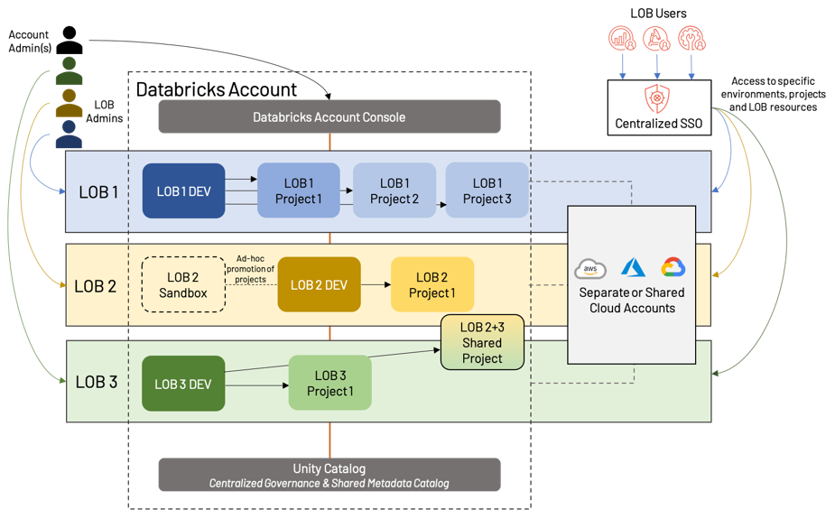
Workflow in Databricks Lakehouse Platform
The flow from individual lines of business (LOB) through development environments to shared cloud resources is all underpinned by the Unity Catalog for governance and metadata management.
Source: www.databricks.com
Notes:
The compartmentalization of projects within the Databricks environment, with each LOB having distinct development spaces (LOB1 DEV, LOB2 DEV, etc.),.
The Unity Catalog helps in maintaining consistency and governance across different projects and LOBs.
The ad-hoc promotion of projects within LOB2 indicates a flexible, sandbox-style development approach.
The collaboration between LOB2 and LOB3 shows the ability for cross-LOB project sharing.
Separate or shared cloud accounts can be leveraged for resource management and cost optimization.
The centralized Databricks Account Console is the point of access control and project management for the entire organization.

Slide 41
Creating a Notebook in Databricks Workspace
Follow these steps to get started with the Databricks workspace:
Create a Databricks account
Access the Databricks
workspace
01
02
Create a Databricks
workspace
Navigate the Databricks workspace
03
04
Create and import notebooks
05
06
Create a cluster
Notes:
1. Sign up for a Databricks account on the Databricks website.​
2. Log in to the Databricks workspace using your account credentials.​
3. Create a new Databricks workspace if you do not have an existing one.
4. Familiarize yourself with the workspace.
Workspace: organizes notebooks, libraries, and dashboards. ​
Clusters: configures and manages Apache Spark clusters. ​
Notebooks: author and run code using notebooks. ​
Tables: stores and manages data tables. ​
Jobs: Schedules and runs data engineering jobs. ​
Configure a Spark cluster to process your data. Navigate to the Clusters tab and click on "Create Cluster." ​
Adjust the cluster settings based on your requirements (for example, number of nodes, Spark version). ​
6. Create new notebooks to write and run your code. You can import existing notebooks or create new ones directly in the workspace. ​

Slide 42
Understanding Project Cycle in Databricks
01
02
Explore and visualize
data
Connect to data sources
Install libraries
03
04
05
06
Collaborate and share
Create tables and views
Schedule job
07
Explore advanced features
08
Documentation and
training
Monitor and optimize
09
10
Integrate with version control
Notes:
Connect to your data sources, such as data lakes or databases. Databricks supports various connectors and libraries for data access. ​
Install additional libraries if needed for your analysis. Navigate to the Libraries tab and install the required libraries (for example, PySpark, MLlib, etc.).
Use notebooks to explore and visualize your data. leverage built-in visualizations or integrate with tools like Matplotlib or Plotly.
Collaborate with team members by sharing notebooks. Use version control to track changes in notebooks.
Create tables or views to organize and store structured data. Utilize Databricks Delta Lake for transactional capabilities.
Schedule jobs to automate data-processing tasks. Define and configure jobs in the Jobs tab.
Explore advanced features such as MLflow for managing the end-to-end machine learning lifecycle.
Monitor cluster performance and resource usage. Optimize your code and cluster settings for efficiency.
Integrate your Databricks workspace with version control systems like Git for better code management.
Refer to the Databricks documentation for detailed information. Consider training resources and documentation for best practices. ​
Remember that Databricks provides a collaborative and scalable environment for big data analytics, so understanding the features and capabilities of the platform will help you make the most of your workspace.

Slide 43
Environment Configuration
01
Cluster configuration
02
Library management
03
Workspace settings
Advanced cluster configurations
04
Notebook setup
05
Data source connection
06
Notes:
1. Cluster Configuration:​
Navigate to the Clusters tab in the Databricks workspace.​
Create a cluster or configure existing clusters based on your processing needs.​
Adjust cluster settings, such as the number of worker nodes, instance types, and Spark configurations.​
Enable or disable features like auto-scaling and auto-termination.​
2. Library Management:​
Use the Libraries tab to manage libraries for your notebooks and clusters.​
Install additional libraries, including language-specific libraries (for example, Python, Scala, R) and external dependencies.​
Specify library versions to ensure compatibility with your code.​
3. Workspace Settings:​
Configure workspace settings for improved collaboration and organization.​
Set up folders to organize notebooks and other assets.​
Define workspace access controls and permissions for users and groups.​
4. Notebook Setup:​
Create or import notebooks to start working on your data and analysis.​
Leverage the built-in support for multiple programming languages, including Python, Scala, R, and SQL.​
Organize notebooks into logical folders within the workspace.​
5. Data Source Connection:​
Connect Databricks to your data sources, such as data lakes, databases, or external storage.​
Utilize built-in connectors or install additional libraries for specific data sources.​
6. Advanced Cluster Configurations:​
Explore advanced cluster configurations for specific use cases.​
Configure Spark options, environment variables, and init scripts.​
Customize Spark configurations for performance tuning.

Slide 44
Environment Automation and Enhancement
Enhance and automate the Databricks workspace by following these steps:
Job scheduling and
automation
01
Dashboard and visualization customization
02
Version control integration
Environment variables
03
04
Security configuration
Databricks CLI and APIs
05
06
Notes:
7. Job Scheduling and Automation:​
Schedule and automate jobs for recurring data processing tasks.​
Use the Jobs tab to create and manage jobs with configurable scheduling options.​
Schedule notebooks, libraries, or external files as jobs.
8. Dashboard and Visualization Customization:​
Create dashboards and visualizations to monitor and analyze data.​
Customize dashboards with visual elements like charts, tables, and widgets.​
Use widgets to filter and interact with data dynamically.​
9. Version Control Integration:​
Integrate Databricks with version control systems like Git for code management.​
Collaborate with team members by tracking changes in notebooks.​
Use the built-in version control features of Databricks.​
10. Environment Variables:​
Set up environment variables for storing configuration parameters.​
Use environment variables in notebooks or clusters to maintain consistency across different environments (for example, development, testing, production).​
11. Security Configuration:​
Implement security measures to protect your Databricks environment.​
Configure access controls, authentication methods, and network settings.​
Utilize Databricks Workspace logs for auditing and monitoring.​
12. Databricks CLI and APIs:​
Explore the Databricks Command-Line Interface (CLI) and APIs for programmatic management.​
Automate environment setup and configuration using scripts and API calls.

Slide 45
Environment Configuration and Customization​
Integration with other tools
Monitoring and optimization
01
02
Custom libraries and dependencies
Documentation and
training
03
04
Notes:
13. Integration with Other Tools:​
Integrate Databricks with other tools in your data ecosystem.​
Connect to data warehouses, data lakes, BI tools, and machine learning frameworks.​
14. Monitoring and Optimization:​
Monitor cluster performance and resource usage.​
Optimize Spark configurations and notebook code for efficiency.​
Utilize Databricks Runtime features for performance enhancements.​
15. Custom Libraries and Dependencies:​
If needed, package custom libraries and dependencies for distribution.​
Make sure that your notebooks and clusters have access to the required dependencies.​
16. Documentation and Training:​
Document the environment configuration and customization for reference.​
Provide training to users on best practices and conventions.​
By following these steps, you can configure and customize your Databricks environment to meet the specific requirements of your data analytics and machine learning workflows. Regularly review and update configurations based on evolving needs and best practices.​

Slide 46
Data warehouse acts as central repositories that store structured data. Data Lake serves as storage space for both unprocessed and organized data.
Lakehouse architecture aims to combine the best aspects of both data warehouses and data lakes.
Notebooks, clusters, and jobs form the core of the Databricks platform, providing a collaborative and scalable environment for big data processing.
DBFS is distributed file system integrated within Databricks workspaces, ensuring its accessibility across all clusters in Databricks.
Delta Lake is commonly used in Databricks environments to manage and optimize large-scale data processing workflows.

Slide 48
Which data warehouse feature provides a reliable and consistent environment and offers security and compliance across diverse data types and sources?
1
Unified platform
Schema evolution
Query performance
Data governance

Slide 49
Which data warehouse feature provides a reliable and consistent environment and offers security and compliance across diverse data types and sources?
1
Unified platform
Schema evolution
Query performance
Data governance
D
Data governance plays a crucial role in providing a reliable environment. It establishes policies for data quality, security, and compliance, ensuring that data is managed in a standardized and controlled manner.

Slide 50
What benefit does Lakehouse architecture provide for the management of data schemas?
2
A complete data restructuring is necessary for any alternations to the schema.
It supports only a schema-on-write approach.
It provides schema flexibility to accommodate evolving data and diverse data types.
It prohibits evolutionary changes to the schema, ensuring data stability.

Slide 51
What benefit does Lakehouse architecture provide for the management of data schemas?
2
A complete data restructuring is necessary for any alternations to the schema.
It supports only a schema-on-write approach.
It provides schema flexibility to accommodate evolving data and diverse data types.
It prohibits evolutionary changes to the schema, ensuring data stability.
C
Lakehouse architecture allows for both schema-on-write and schema-on-read approaches, making it adaptable to changing data requirements without needing a complete overhaul of the existing data structure.

Slide 52
In context of Databricks, which of the following statements describes notebooks and clusters?
3
Notebooks in Databricks cannot access DBFS directly and require special permissions.
Clusters within a Databricks workspace have shared access to DBFS, allowing for collaborative file usage and analysis.
Notebooks have no utility to manage files within DBFS, and file operations can only be conducted through the Databricks workspace UI.
Clusters cannot mount external storage to DBFS and require direct integration with cloud object storage.

Slide 53
In context of Databricks, which of the following statements describes notebooks and clusters?
3
Notebooks in Databricks cannot access DBFS directly and require special permissions.
Clusters within a Databricks workspace have shared access to DBFS, allowing for collaborative file usage and analysis.
Notebooks have no utility to manage files within DBFS, and file operations can only be conducted through the Databricks workspace UI.
Clusters cannot mount external storage to DBFS and require direct integration with cloud object storage.
B
DBFS is accessible through notebooks, jobs, and clusters in a Databricks workspace, which implies shared access for collaborative purposes.

Slide 54
Which of the following statements correctly reflects the features of the Databricks File System (DBFS)?
4
DBFS uses cloud object storage as the underlying storage layer.
The dbfs:/mnt directory is typically used for mounting external storage.
The dbfs:/FileStore directory is reserved exclusively for system files and configurations.
DBFS does not support file operations through %fs commands in notebooks and jobs

Slide 55
Which of the following statements correctly reflects the features of the Databricks File System (DBFS)?
4
DBFS uses cloud object storage as the underlying storage layer.
The dbfs:/mnt directory is typically used for mounting external storage.
The dbfs:/FileStore directory is reserved exclusively for system files and configurations.
DBFS does not support file operations through %fs commands in notebooks and jobs.
A and B
DBFS integrates with cloud object storage, and in Azure Databricks, it uses Azure Blob Storage. The dbfs:/mnt directory is often used when mounting external storage to DBFS, and dbfs:/FileStore directory is reserved exclusively for system files and configurations.

